Slide 1

Product Recommendation using ML

Slide 2
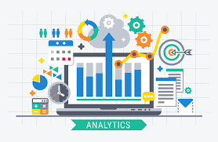
Product Recommendation using ML
By Tejal Parmar

Slide 3

Outline
Objective
Data Collection & Data Dictionary
Data Cleaning
EDA
Insights
Modeling
Conclusion

Slide 4

Objective
Understanding Marketing Analytics enables companies or businesses to avoid missing out on their chance to show targeted recommendations based on user’s preferences.
Applying Machine Learning & Data Analytics techniques using R.
Performing product and customer trend analysis to gain insights.
Using RFM Modeling to divide customers into clusters based on purchase histories.
Identifying marketing strategies for different customer segments to promote customer satisfaction.

Slide 5
Data Collection
Data is downloaded from https://data.world/cannata/superstoreorders
Dataset consists of online orders / transactions of SuperStore for 3 departments :
1. Furniture 2. Office Supplies 3. Technology
Dataset is in csv format of approximately 16k rows and 27 columns.

Slide 6
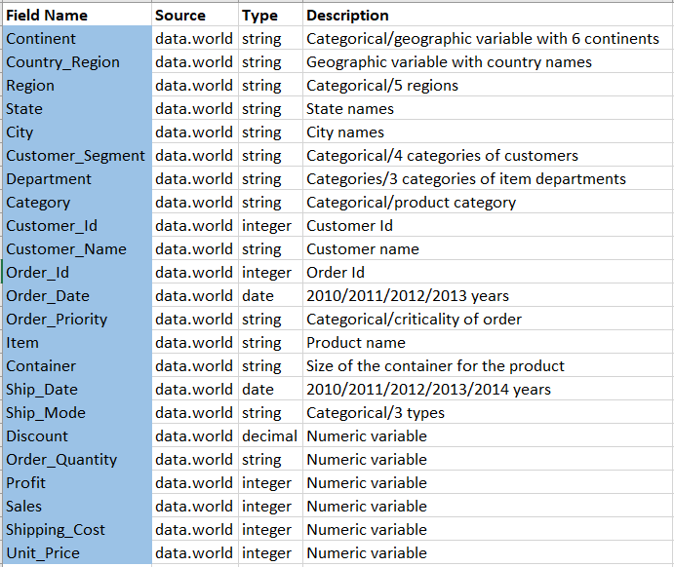

Data Dictionary

Slide 7
Data Cleaning
Missing values were removed using omit() function
Removing duplicate values using unique() function
Removing item names that contain only digits
Extracting first word from product name to populate ‘Brand’ as a new variable
Disregard the columns ‘Row_Id’, ‘Postal_code’ and ‘Number_of_Records’

Slide 8
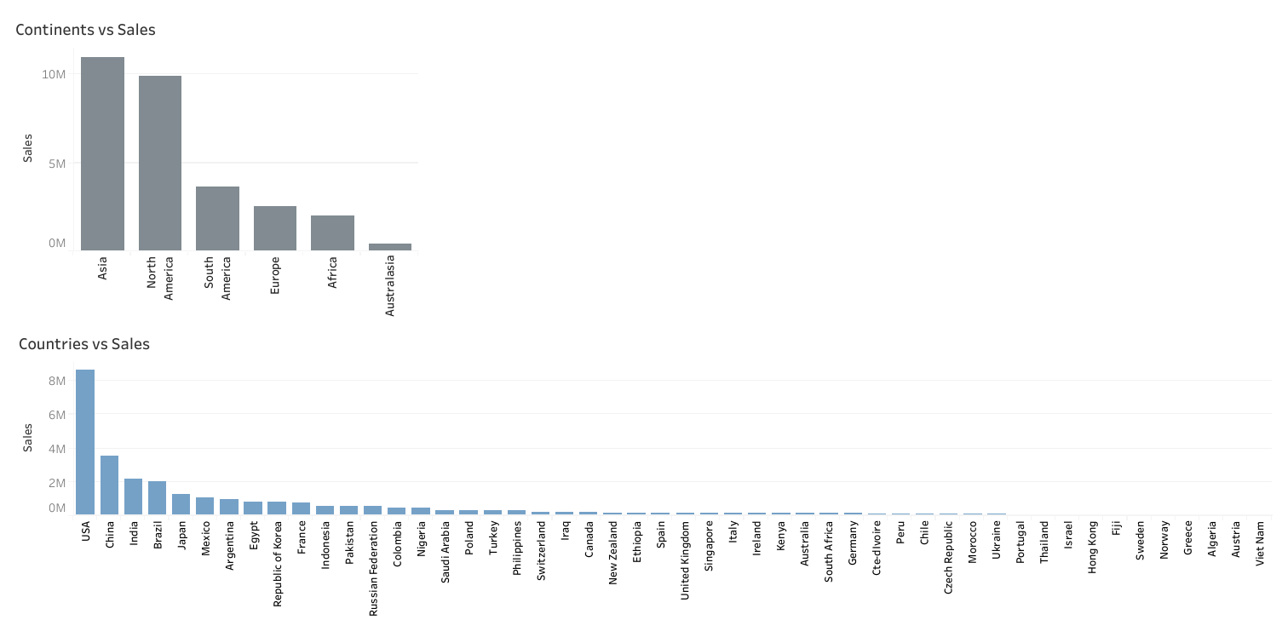
EDA : Dashboard - 1

Slide 9
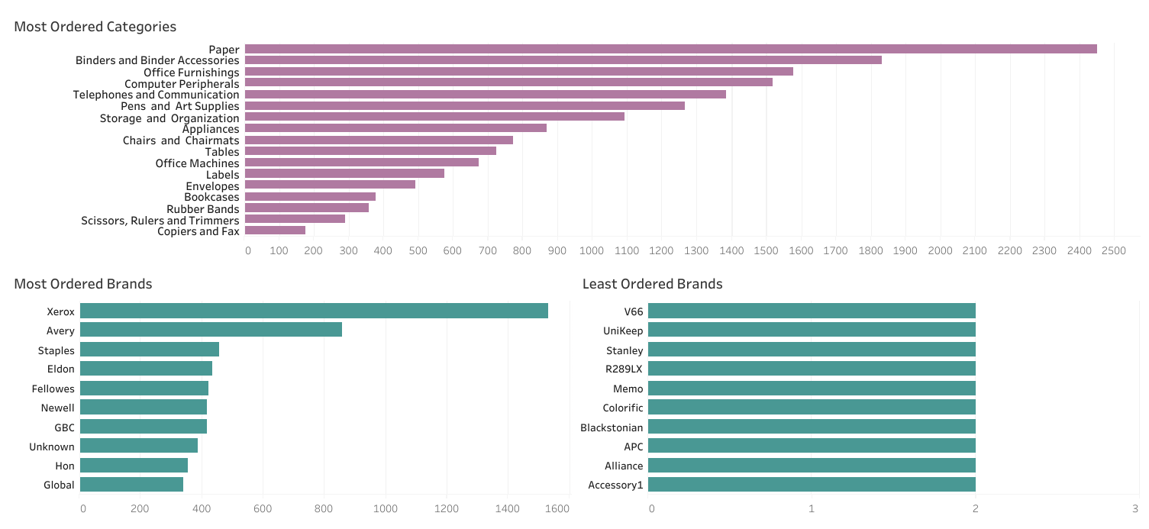
EDA : Dashboard - 2

Slide 10
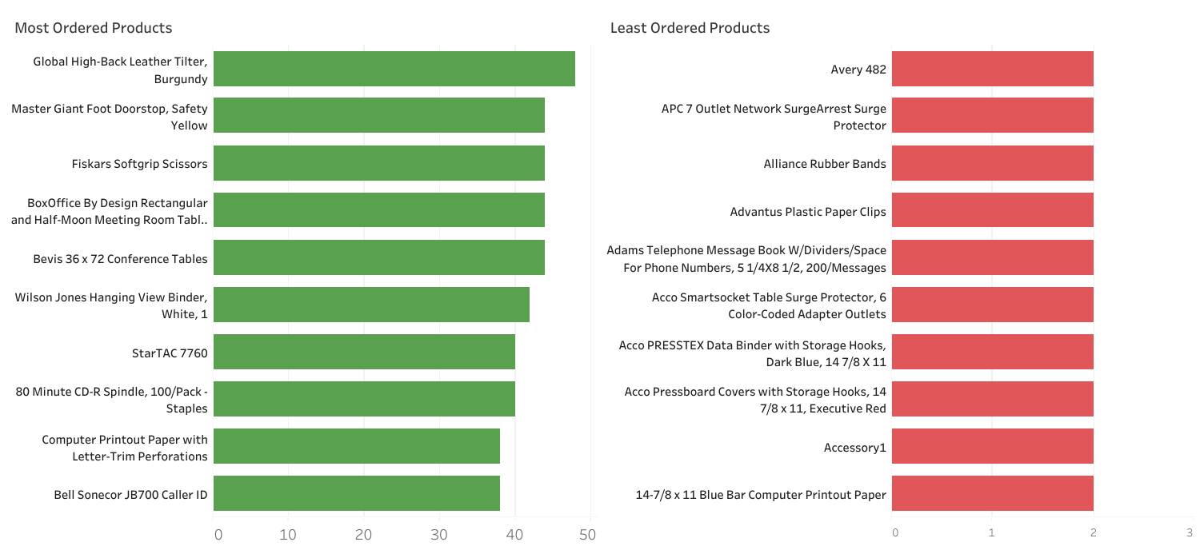
EDA : Dashboard - 3

Slide 11
Insights
For businesses it is crucial to understand customers to optimize their marketing strategies and spending on marketing ads
To divide the customers into different groups based on demographic information, psychographic information or purchasing behavior.
You probably don’t want to exhaust all your marketing budget on customers who are already big spenders with a history of high purchase frequency, recency or high-value purchases.
Instead you may like to allocate your budget to customers deemed ‘at-risk’ of churning - e.g., former e-commerce visitors who have been lurking around but haven’t made their first purchase yet.

Slide 12
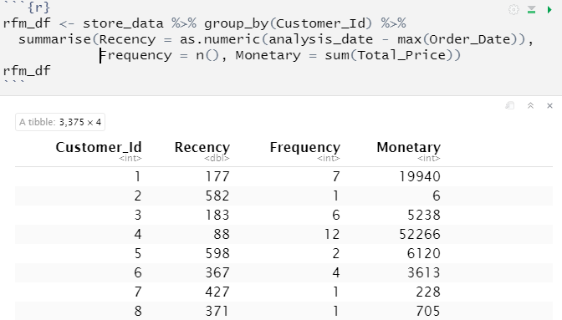
Modeling - RFM Analysis
In R, there’s a package called rfm to help marketers segmenting their customer based on their Recency, Frequency and Monetary (RFM)

Slide 13
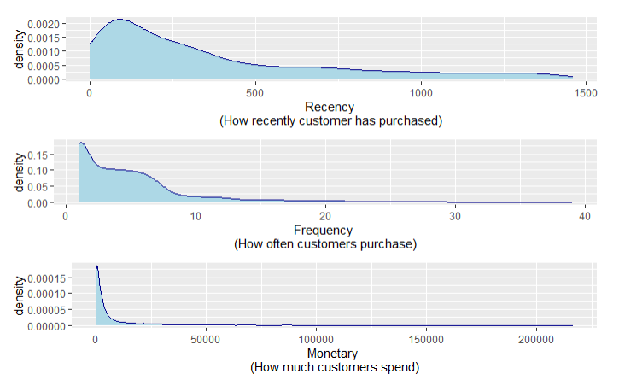
Density Plots of RFM Distribution

Slide 14
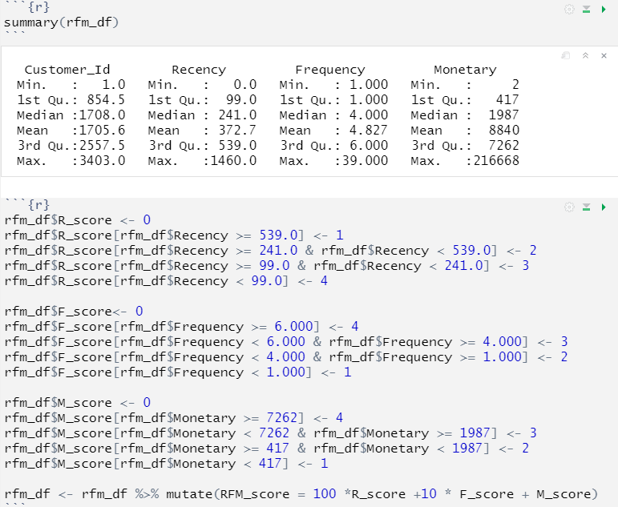
Calculating RFM Score

Slide 15
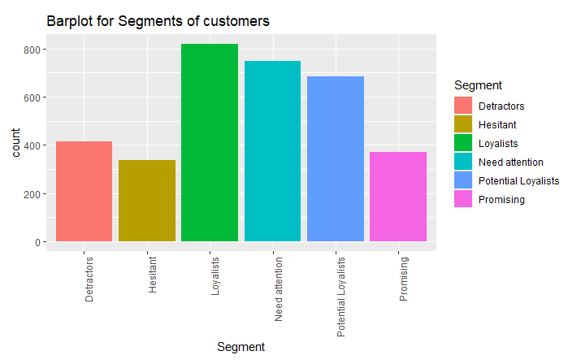
Customer Segmentation based on RFM_score

Slide 16
Understanding Customer Segments
Loyalists - The champion customers who love to buy and should be rewarded so they remain loyal to your business.
Potential Loyalists - They like your products but probably don’t love it, so persuade them to spend more money with you by coming up with attractive offers and festive discounts.
Promising - They have had a good purchase history but not great lately. Ask for feedback, offer the best customer experience and provide personalized digital marketing.
Hesitant - The passive customers, assess their feedback through online/physical surveys to understand their expectations and exceed it every time.
Need attention - If no suitable action is taken, these customers have a risk of becoming the detractors. We must prevent this by understanding the needs of this segment and offer them tailor made offers/discounts to make them excited about our business.
Detractors - These customers might have been disappointed with the service in the past and no longer want to come back. Detractors have a high probability of giving bad reviews and bad-mouthing the service. Strategize the actions to follow up with the detractors. Address any concerns, make improvements, and offer rectification, if possible.

Slide 17
Conclusion
Exploring the insights to identify most popular and least popular products and brands, sales comparison in different locations.
Introduction to RFM analysis following with customer segmentation
Visualization of segments into simple bar plot providing the clarity that allows the rest of the decision-making team to quickly identify revenue bottlenecks, growth opportunities and create tactical plans tailored for each customer segment.

Slide 18
References
https://data.world/cannata/superstoreorders
https://medium.com/analytics-vidhya/customer-segmentation-using-rfm-analysis-in-r-cd8ba4e6891
https://supertype.ai/notes/rfm-analysis-r-examples/#:~:text=With%20R%2C%20there's%20a%20package,a%20customer%20has%20purchased%20(Recency)

Slide 19
Thanks

